Slide 1





Sales Analysis
By Eng.Ahmed Saber

Slide 2
Content:
Comprehensive Business Assessment
Structured Evaluation
Data Overview
Bussiness Objectives
Analysis & Interpretation of business requirements

Slide 3
Data Overview:
This dataset contains sales transactions, covering order details, product categories, revenue, and profit. It includes key metrics like total sales, discounts, and costs across different regions and product types. The data helps analyze sales performance, profit trends, and the impact of discounts on revenue. Some columns have missing values, requiring cleaning. Overall, it provides valuable insights into business performance and sales strategies
Threats

Slide 4


Analysis Objectives:
01
Assist in the decision-making process by answering business requirements.
Evaluate Sales Performance – Identify the best-selling products and highest-revenue regions
02
Detect Seasonal Patterns & Identify Regional Trends
03

Slide 5
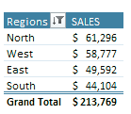
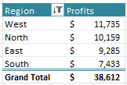
Business Requirements Analysis
After processing and analysis the data and defining the requirements, we will now begin Answering business requirements ,Now we will start with the region :
Analyze Factors
Prioritize Insights
After analyzing and studying the data
We knew that North is the highest in sales.
And knew that west is highest in Profits

Slide 6
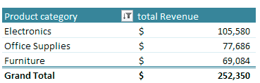
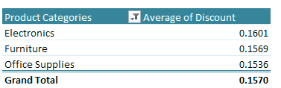
As for the product category, we discovered that
Electronics is contributes the most to our revenue
the average discount offered across different product categories
It shows that electronics is highest

Slide 7
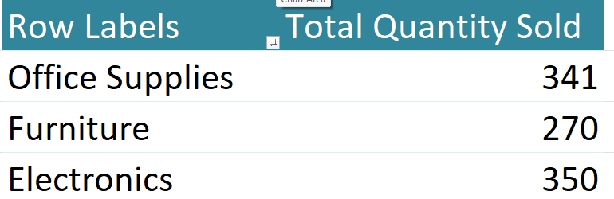
the total order quantity for each product category It shows that
electronics is highest
After analysis and study, we discover that electronics is One of our best product categories

Slide 8
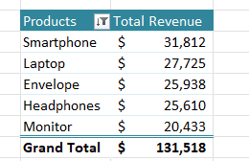
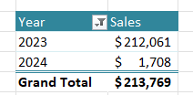
As for our products, we have reached the point where top 5 best-selling products by revenue.
There are seasonal trends, as sales increased significantly in 2023 and then decreased in 2024.

Slide 9
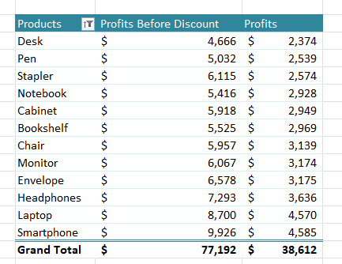
The discount percentage on the product has reached 50% of the profits for each product.
As the profits of each product reached half

Slide 10
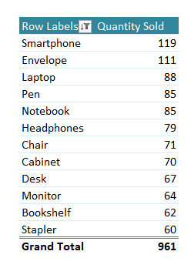
Based on the quantity sold of each product, we have concluded that there are products for which we must have a large stock.
This table shows a comparison between the products and the quantity sold for each product.

Slide 11
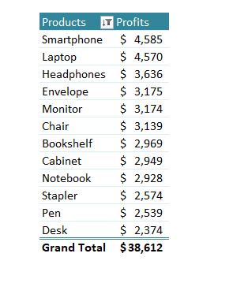
We were able to make a comparison between the profits of each product over the years 2023 and 2024.
We know how to identify the products that affect our profits over the course of two years.

Slide 12
In the end, we reached the conclusion that in 2023 and 2024, we will achieve sales of up to $ 213,769.
We made a profit of up to $ 38,612
With a cost of up to $ 175,158

Slide 13
THANK YOU

